Slide 1
My Health Keeper
Team Aide
Siana Rizwan (180042105)
Farzana Tabassum (180042119)
Sabrina Islam (180042122)

Slide 2
My Health Keeper is a ONE STOP solution where users can store all sorts of health related information in ONE place
2

Slide 3
Features At A Glance…..
Storing General Health Information
Diet Plan
Storing Specialized Health Information
Report Analysis
Disease Prediction
Medicine Reminder
Menstrual Cycle Tracker

Slide 4
Features Completed
6
Before Progress Presentation
After Progress Presentation
Authentication
Half UI of Storing General Health Information
Medicine Reminder
Menstrual Cycle Tracker
Storing General Health Information
Diet Plan
Storing Specialized Health Information
Report Analysis
Disease Prediction
UI modification and testing

Slide 5
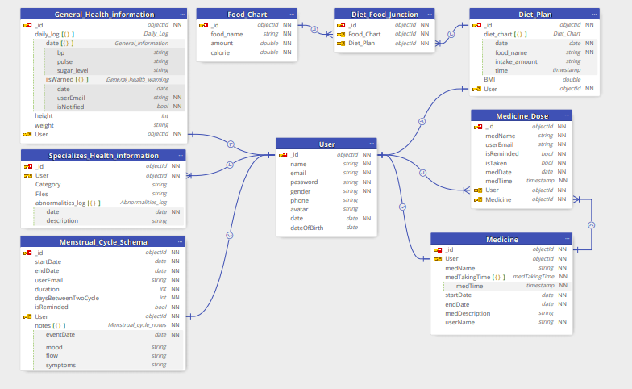
ER-Diagram
5

Slide 6
The floor is open for Q/A
6
Thank You!

